Slide 1
AI and the Future of Work

Slide 2
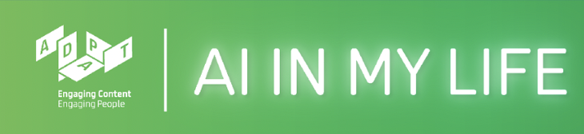
What is AI in My Life?
Workshop series on Artificial Intelligence
Developed by ADAPT research centre and partners
Designed to help students navigate the ’Age of AI’
Our Partners:
Notes:
AI in My Life is a modular workshop series on Artificial Intelligence (AI)
It was developed by the Science Foundation Ireland ADAPT Research Centre
ADAPT is a major academia-industry research centre with more than 300 researchers from 8 Irish universities (led by Trinity College Dublin and Dublin City University) producing research and innovations in many aspects of AI
Partners on the project include, for example, DCU Access, Amazon Web Services and the Lero software research centre

Slide 3
What you’ll learn today
The role that AI plays in many industries
The way that AI is transforming the world of work
Why AI requires expertise of people from many fields
The kinds of skills that are required for AI
Our Partners:

Slide 4
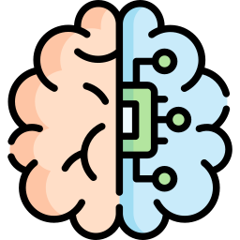

What is AI?
Artificial intelligence refers to many different technologies that are designed to accomplish tasks that can otherwise be only carried out by human minds, for example identifying patterns, recognising images, understanding languages or solving problems.
*https://www.accenture.com/us-en/insights/artificial-intelligence-summary-index
This work is licensed under a Creative Commons Attribution-NonCommercial-ShareAlike 4.0 International License
Notes:
Comprehend = understand
Sense = detect
Through AI, we can programme machines to plan, learn, reason, solve problems, and make decisions.

Slide 5

AI and the World of Work
What kind of industries
have we seen impacted by AI?
This work is licensed under a Creative Commons Attribution-NonCommercial-ShareAlike 4.0 International License

Slide 6
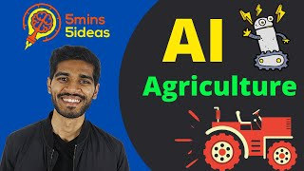
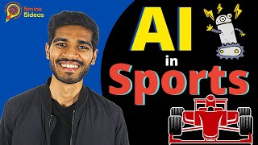
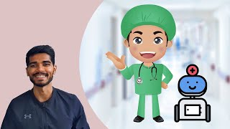
AI and the World of Work
Uses of AI in Agriculture
Uses of AI in Sport
Uses of AI in Healthcare
ttps://www.youtube.com/watch?v=KpZMEU9wIb8
https://www.youtube.com/watch?v=tX0ou7oZ4Jg&list=PLdq6aTitdRWbtPed2R6_n9Qh0BqeB6_mD&index=5
https://www.youtube.com/watch?v=CStXwaFNoXM&list=PLdq6aTitdRWbtPed2R6_n9Qh0BqeB6_mD&index=3
This work is licensed under a Creative Commons Attribution-NonCommercial-ShareAlike 4.0 International License

Slide 7

AI and the World of Work
AI will affect almost every sector of the economy and society
Almost everyone will need some knowledge of AI as it becomes embedded into our jobs and lives
Those who have the skills to work in this changing environment will benefit the most
Source: AI Skills: A Preliminary Assessment of the Skills Needed for the Deployment, Management and Regulation of Artificial Intelligence. Expert Group on Future Skills Needs, May 2022
This work is licensed under a Creative Commons Attribution-NonCommercial-ShareAlike 4.0 International License

Slide 8
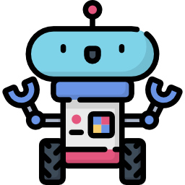
Will a robot take my job?
Are you worried about the
impact of AI on jobs in the future?
This work is licensed under a Creative Commons Attribution-NonCommercial-ShareAlike 4.0 International License

Slide 9

Will a robot take my job?
1 in 3 jobs in Ireland are at high risk of being disrupted by the adoption of digital technologies
BUT
Much of the disruption will result in changes to job roles and tasks performed by individuals rather than job losses
Digital Transformation: Assessing the Impact of Digitalisation on Ireland’s Workforce.
Expert Group on Future Skills Needs, 2018
This work is licensed under a Creative Commons Attribution-NonCommercial-ShareAlike 4.0 International License

Slide 10

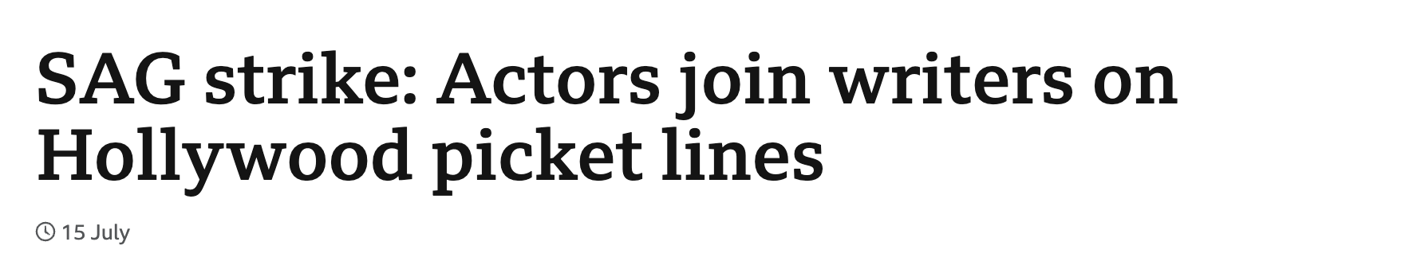
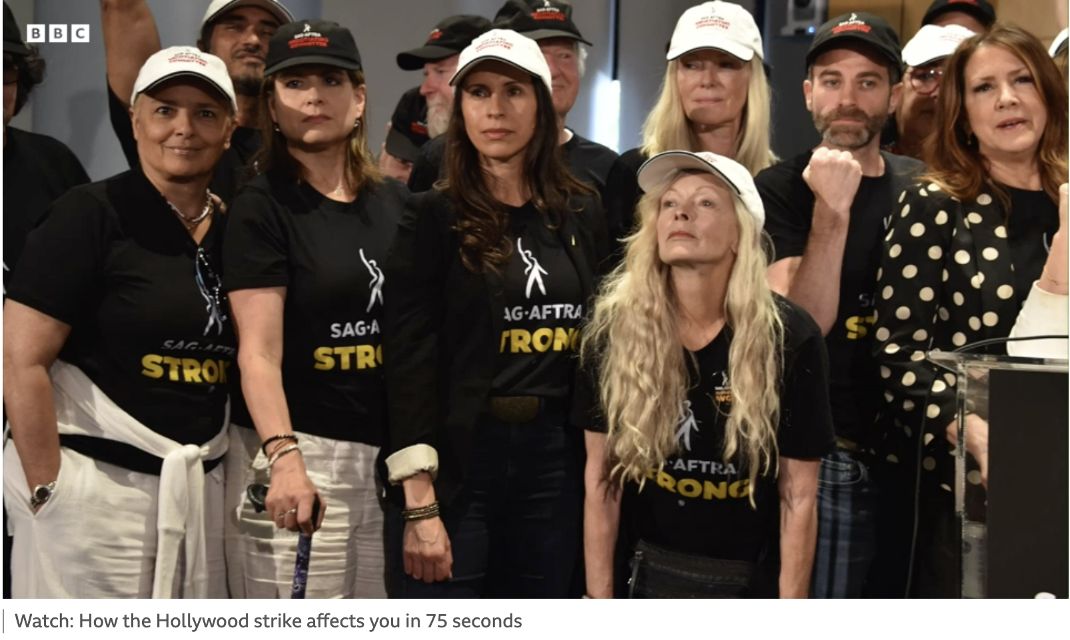
Will a robot take my job?
https://www.bbc.com/news/av-embeds/66205719/vpid/p0g10c2v
This work is licensed under a Creative Commons Attribution-NonCommercial-ShareAlike 4.0 International License

Slide 11
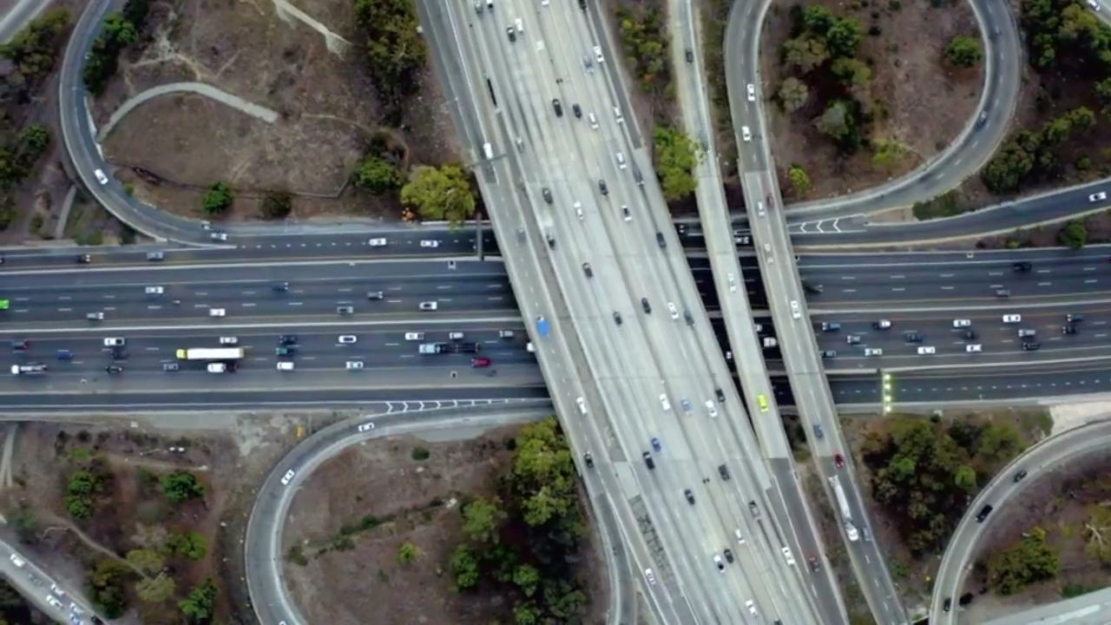
Will a robot take my job?
The Age of A.I. S1 E6 Will a robot take my job? | The Age of A.I.
This work is licensed under a Creative Commons Attribution-NonCommercial-ShareAlike 4.0 International License

Slide 12
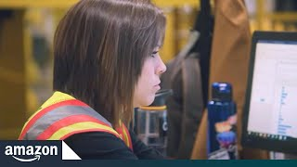
Will a robot take my job?
Whether jobs will be transformed rather than replaced will depend mainly on
how well the strengths of AI and the strengths of the human complement each other:
Some lower-skilled jobs might be lost, especially if they can be easily automated
In general, AI and humans are more likely to work well together in highly-skilled jobs, so these jobs will be transformed rather than lost
Digital Transformation: Assessing the Impact of Digitalisation on Ireland’s Workforce.
Expert Group on Future Skills Needs, 2018
This work is licensed under a Creative Commons Attribution-NonCommercial-ShareAlike 4.0 International License

Slide 13
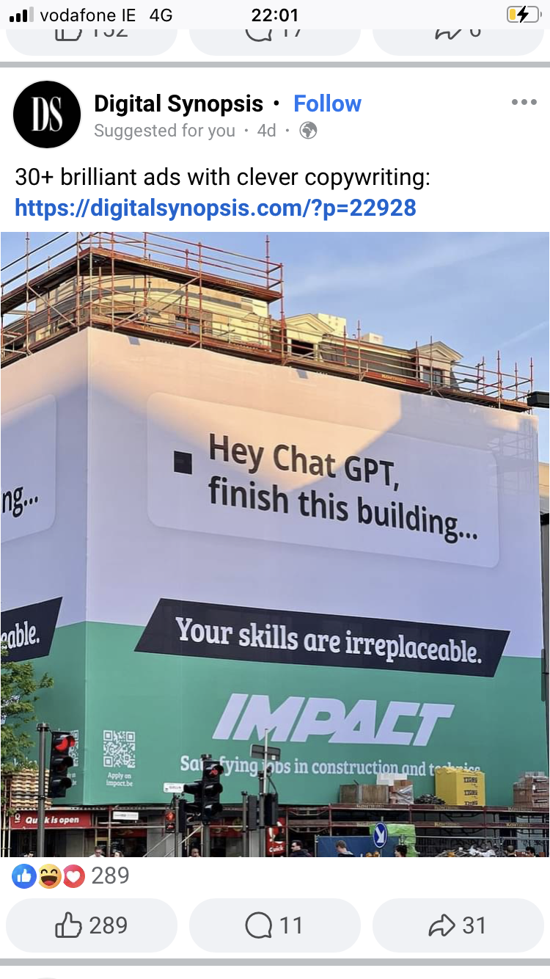
Will a robot take my job?
Think back to our introduction to AI.
Can you remember which kind of tasks AI finds hardest to carry out?
Jobs relying on these skills are least likely to be replaced by AI.
This work is licensed under a Creative Commons Attribution-NonCommercial-ShareAlike 4.0 International License

Slide 14
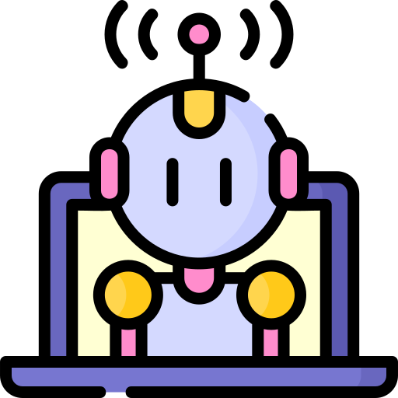
Will a robot take my job?
The main message is that AI skills are not just for AI experts. Everyone will need knowledge of AI and its implications.
People developing AI will need specialist AI skills
People working in organisations using AI will need knowledge of how AI works
AI Skills: A Preliminary Assessment of the Skills Needed for the Deployment, Management and Regulation of Artificial Intelligence, Expert Group on Future Skills Needs, May 2022
This work is licensed under a Creative Commons Attribution-NonCommercial-ShareAlike 4.0 International License

Slide 15
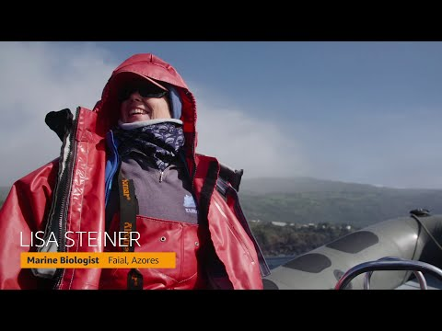
AI is truly multidisciplinary
“AI is perhaps the only technology field that not only provides opportunity for non-technical professionals, but actually requires their input.”
AI aims to imitate human thinking and decision-making.
This is a hugely complex task, so it requires people from all fields to apply their knowledge and expertise to AI.
Opening doors of opportunity:
AI as a vehicle for diversity and inclusion.
Deloitte AI Institute, 2021
https://www.youtube.com/watch?v=ZZs4R-5u4g4
This work is licensed under a Creative Commons Attribution-NonCommercial-ShareAlike 4.0 International License

Slide 16

AI is truly multidisciplinary
For example:
You’ve injured your leg in a football match and are brought to A&E. A nurse performs an initial assessment on your injury, then uses an AI tool that reviews your assessment information, consults all medical literature, and produces a recommendation to a doctor on your likely injury and best course of treatment.
What kind of specialists will be required in this scenario?
Adapted from: Opening doors of opportunity:
AI as a vehicle for diversity and inclusion.
Deloitte AI Institute, 2021
This work is licensed under a Creative Commons Attribution-NonCommercial-ShareAlike 4.0 International License

Slide 17
AI is truly multidisciplinary
Consider:
Who would make the algorithms and programmes for the AI tool?
Who would make the machines?
What about how it looks or feels?
Who else needs to provide input?
Medical professionals
Hospital administrators
Experts in patient advocacy and information privacy
…anyone else?
This work is licensed under a Creative Commons Attribution-NonCommercial-ShareAlike 4.0 International License

Slide 18
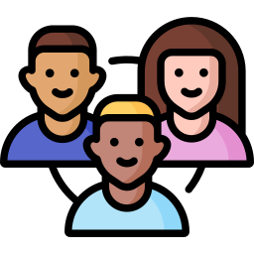
AI is truly multidisciplinary
Why is this multidisciplinarity good?
Drawing so many people into the effort creates opportunities and promotes diversity and inclusion in an emerging professional field
There’s a role to suit everyone!
This work is licensed under a Creative Commons Attribution-NonCommercial-ShareAlike 4.0 International License

Slide 19

How can I future proof myself?
“In the future, you’ll be paid based on how well you work with robots.”
Kevin Kelly, Futurologist
This work is licensed under a Creative Commons Attribution-NonCommercial-ShareAlike 4.0 International License

Slide 20
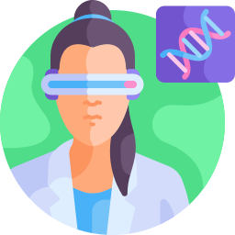
How can I future proof myself?
Learn about AI!
Complete the Careers in AI module
Be ready to adapt to future change
This work is licensed under a Creative Commons Attribution-NonCommercial-ShareAlike 4.0 International License

Slide 21
Will a robot take my job?
Are you worried about the
impact of AI on jobs in the future?
This work is licensed under a Creative Commons Attribution-NonCommercial-ShareAlike 4.0 International License

Slide 22
What have we learned?
AI is transforming many industries
and jobs already
AI is a multidisciplinary field
Everyone needs AI knowledge
This work is licensed under a Creative Commons Attribution-NonCommercial-ShareAlike 4.0 International License
Notes:
Ask students to indicate what are their key takeaways from this lesson?

Slide 23
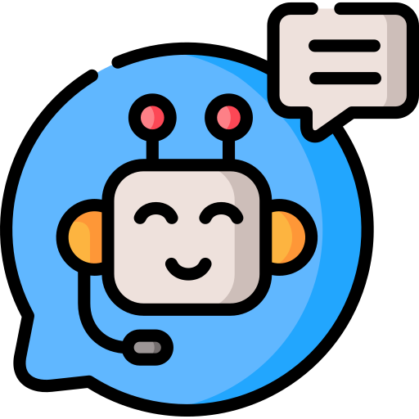
Thanks to our partners:
Want to find out more about AI?
Check out more AI in My Life modules at:
www.adaptcentre.ie/projects/ai-in-my-life/

Slide 24
Thanks to our partners:
Slides from Introduction to AI
Notes:
Add examples like previous slide

Slide 25
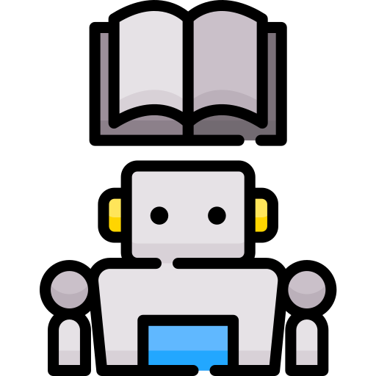
AI Capabilities
Which aspects of “intelligence” do you think machines find hardest to achieve?
This work is licensed under a Creative Commons Attribution-NonCommercial-ShareAlike 4.0 International License
Notes:
What aspects of human intelligence are most difficult to replicate using AI?

Slide 26
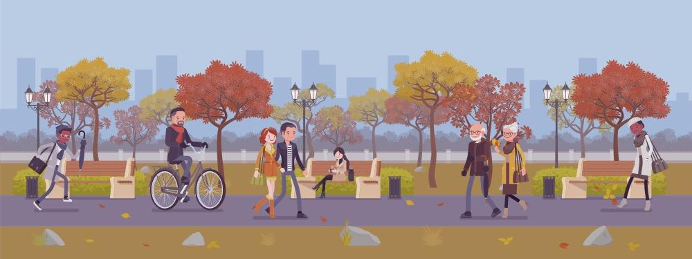
Human Capabilities
Being self-aware
What are humans good at?
Being passionate
Showing compassion
Understanding emotion
Appreciating context
Learning from experience
This work is licensed under a Creative Commons Attribution-NonCommercial-ShareAlike 4.0 International License

